Slide 1


September 4, 2024
Survey of Likely General Election Voters
Michigan Statewide
August 28 – September 1, 2024 | n=600 | ±3.99%

Slide 2
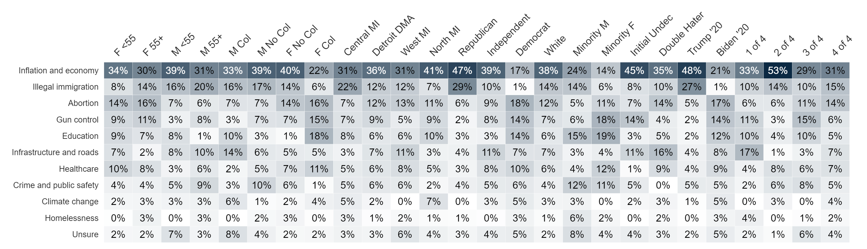

Top Priority
Which one of the following issues is the most important to you in the election for Michigan House of Representatives?

Slide 3
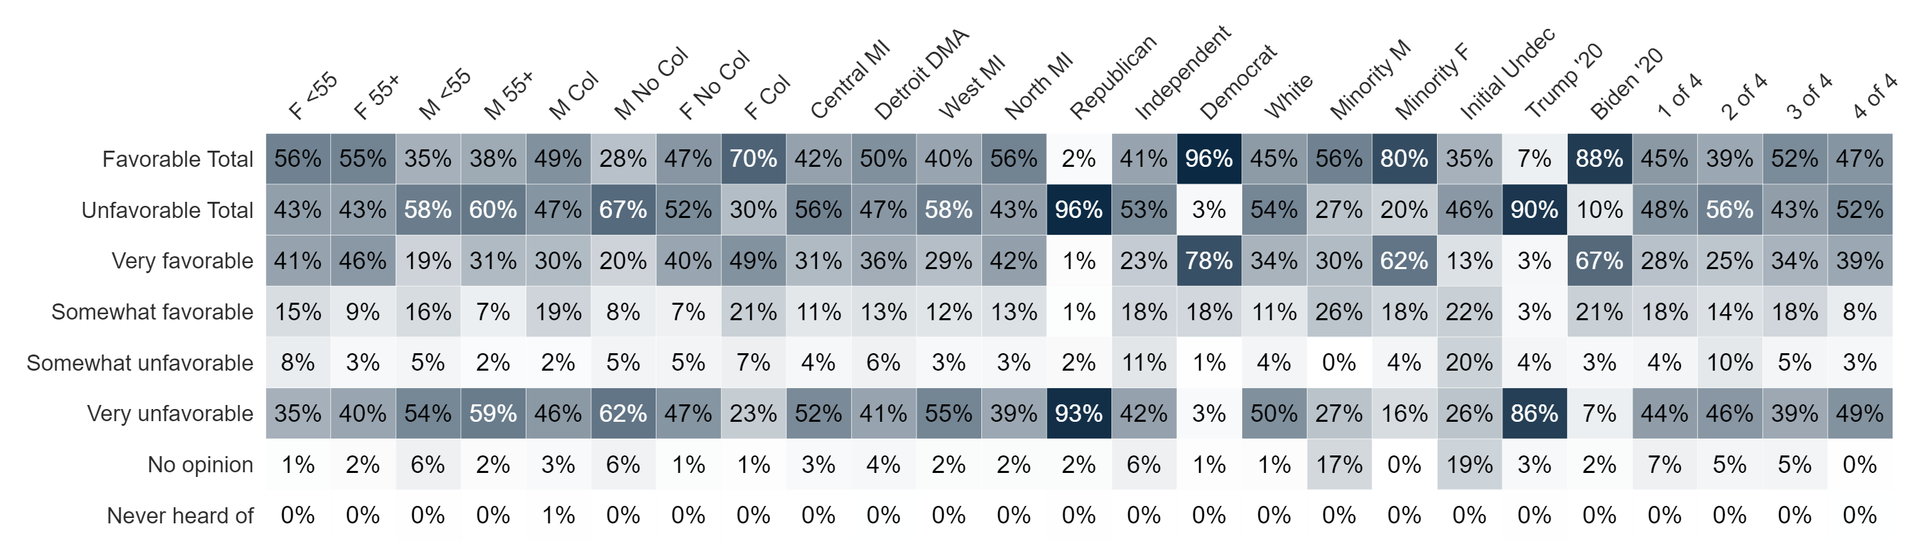
Image: Kamala Harris
Do you have a favorable or unfavorable opinion of Kamala Harris?

Slide 4
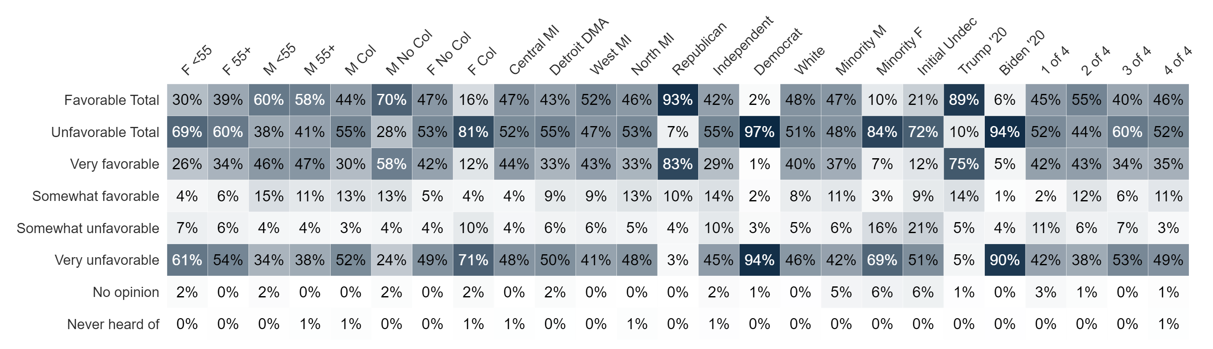
Image: Donald Trump
Do you have a favorable or unfavorable opinion of Donald Trump?

Slide 5
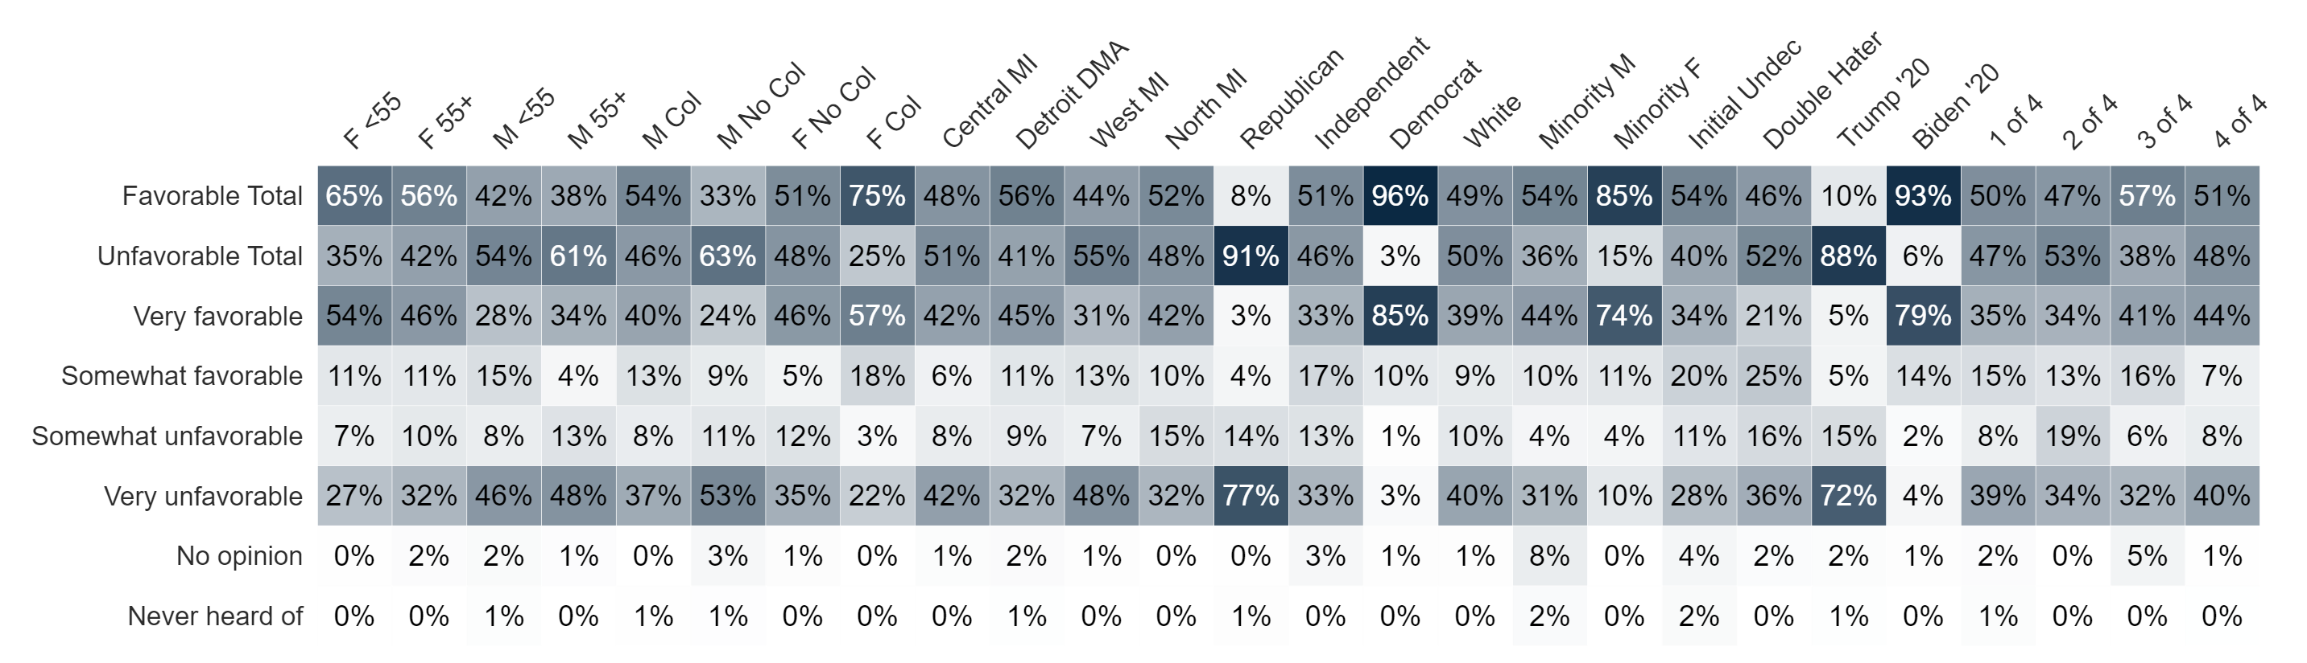
Image: Gretchen Whitmer
Do you have a favorable or unfavorable opinion of Gretchen Whitmer?

Slide 6
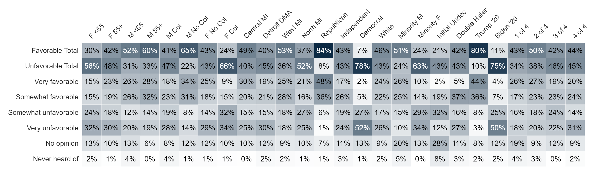
Image: Republicans in the Michigan House of Representatives
Do you have a favorable or unfavorable opinion of Republicans in the Michigan House of Representatives?

Slide 7
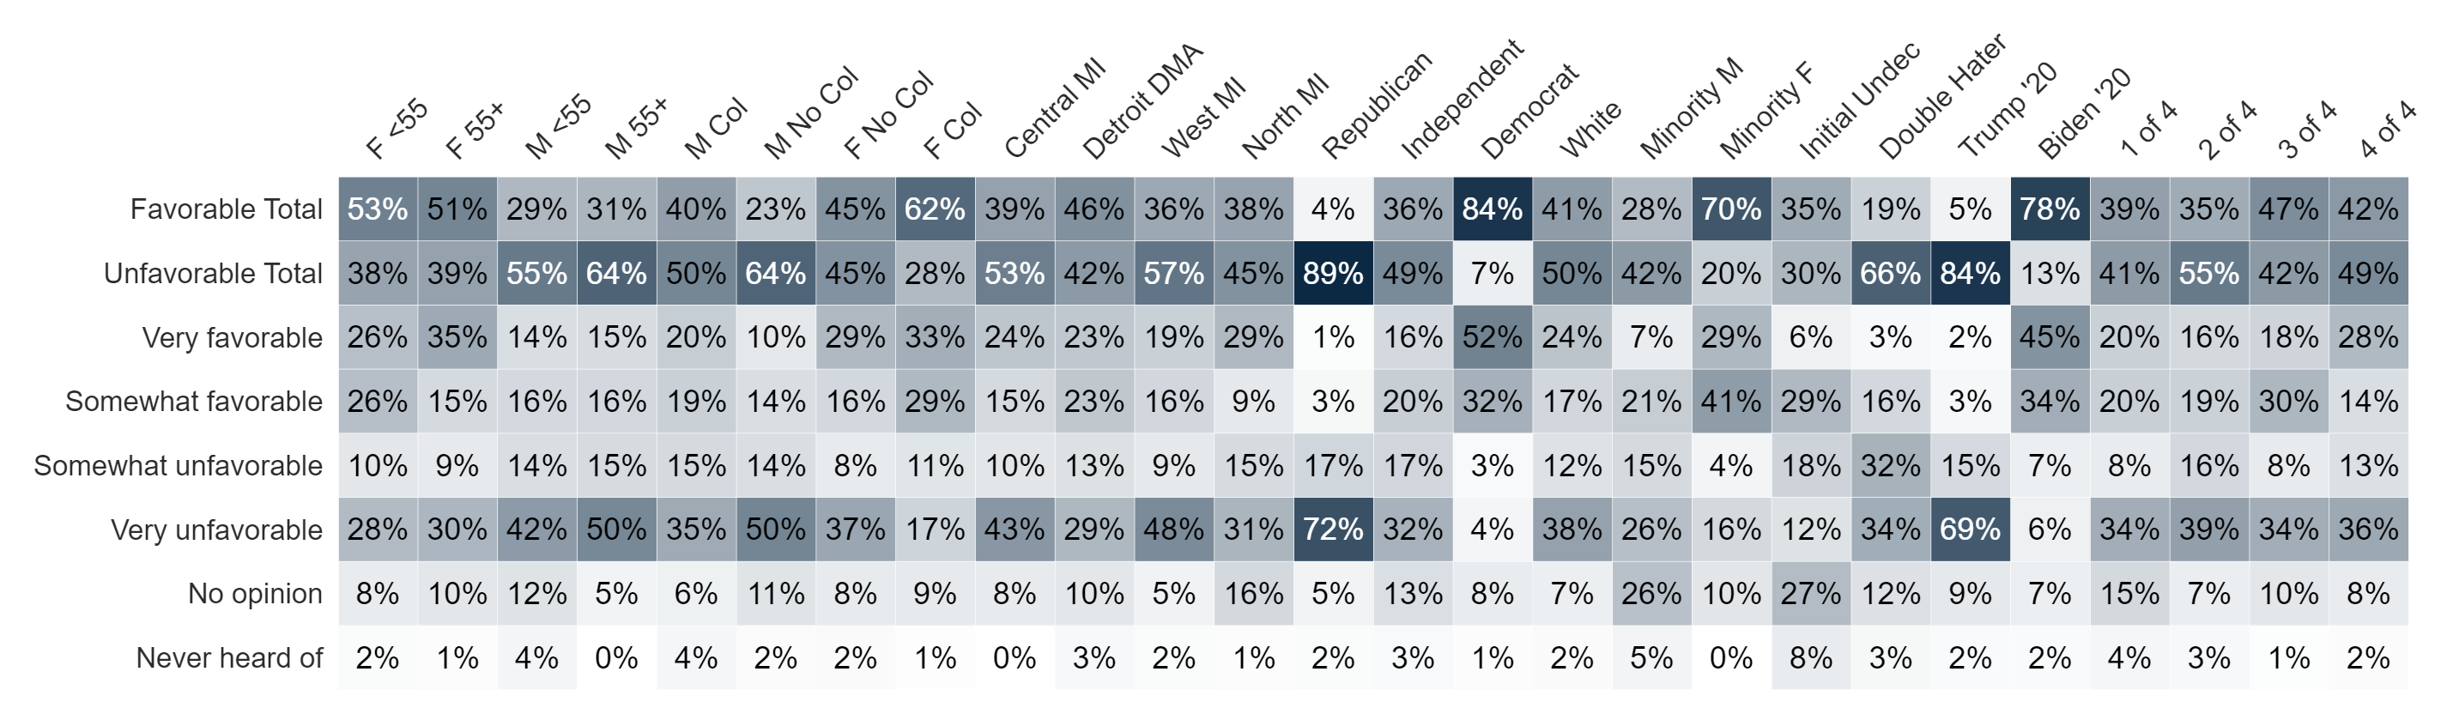
Image: Democrats in the Michigan House of Representatives
Do you have a favorable or unfavorable opinion of Democrats in the Michigan House of Representatives?

Slide 8
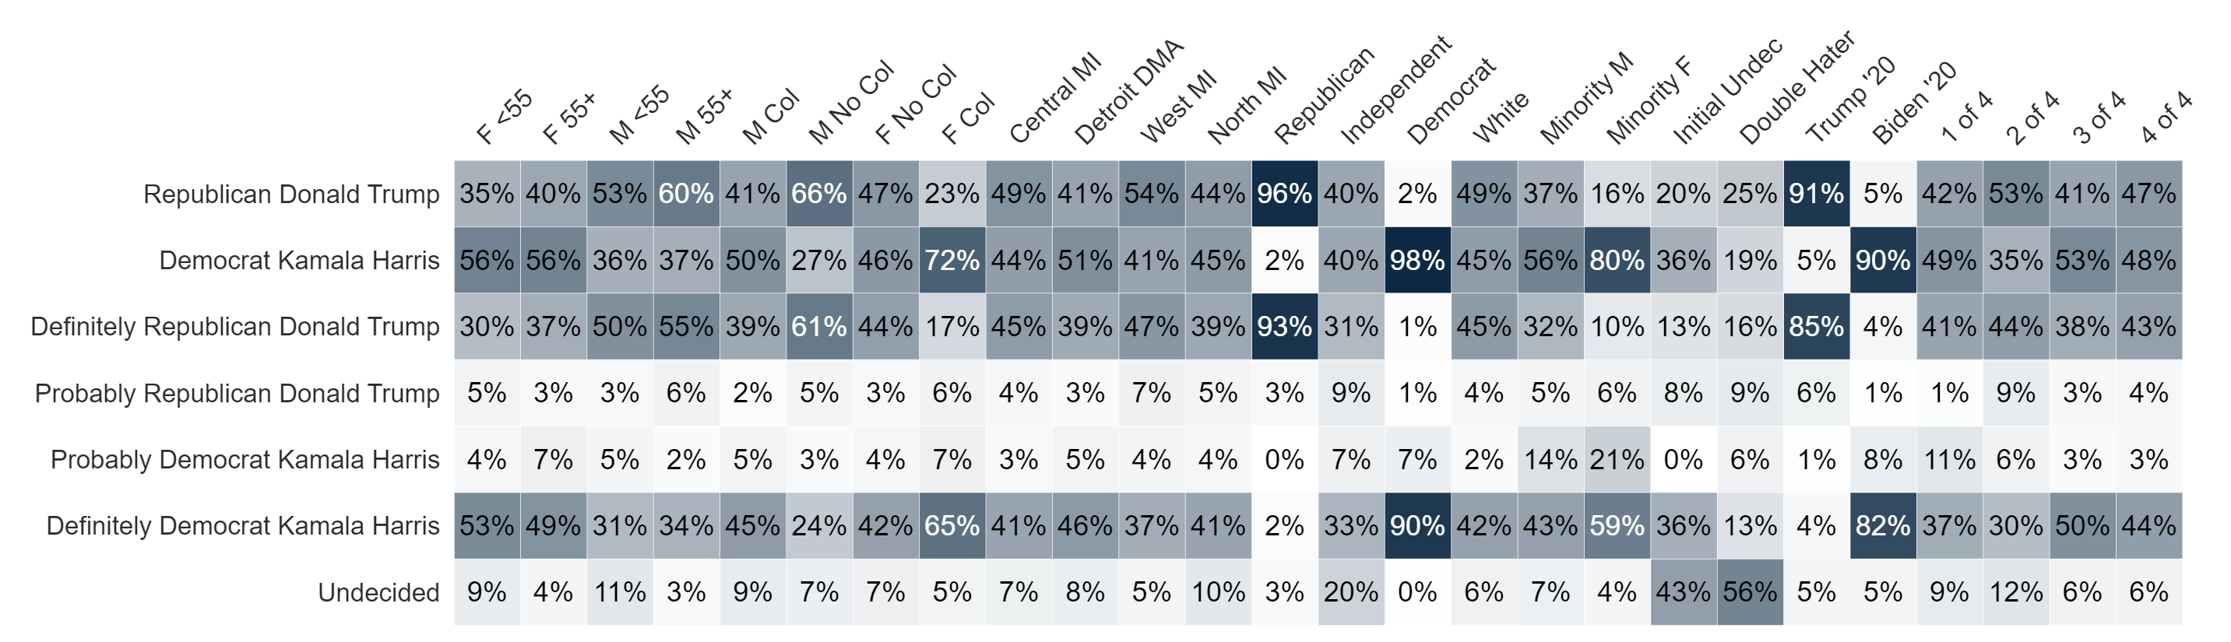
Presidential Ballot Two-Way
If the general election for President was held today between just the following candidates, and you had to make a choice, who would you vote for?

Slide 9
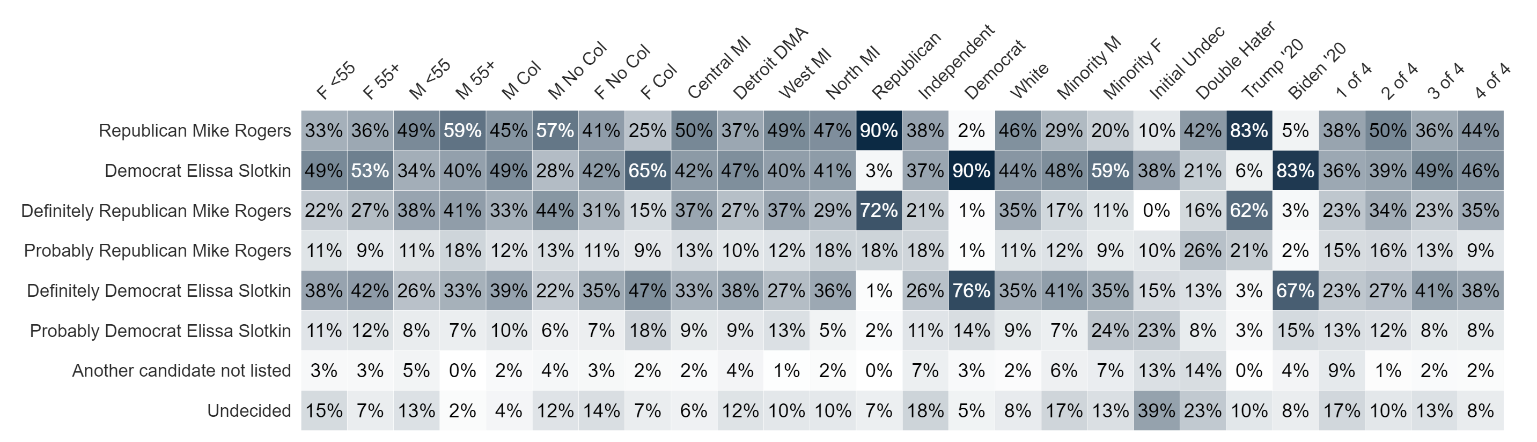
U.S. Senate Ballot
If the general election for U.S. Senate was held today between the following candidates, and you had to make a choice, who would you vote for?

Slide 10
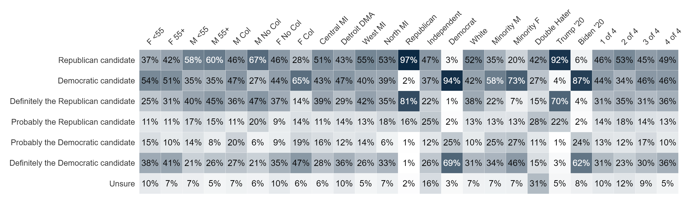
Generic Ballot
If the election was held today, and you had to make a choice, would you vote for the Republican or Democratic candidate for Michigan House of Representatives?

Slide 11
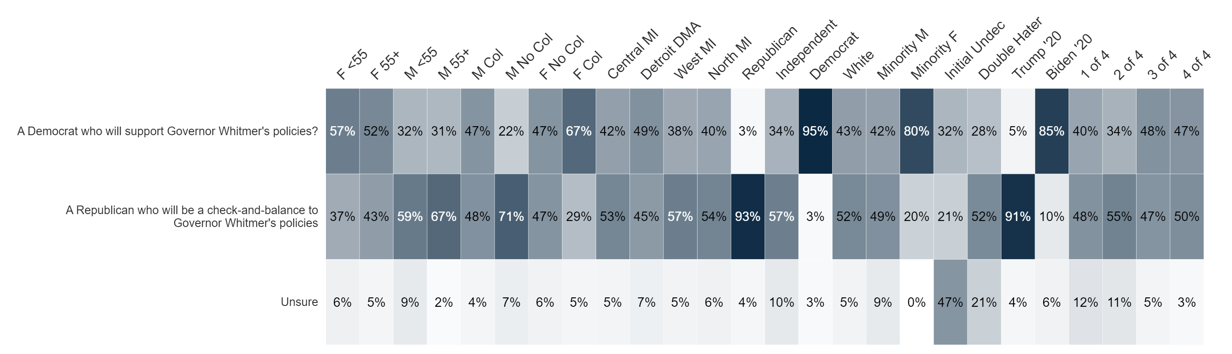
Contrast Ballot
And thinking again about the race for Michigan House of Representatives, which one of the following candidates would you vote for?

Slide 12
Political Party Trust

Slide 13


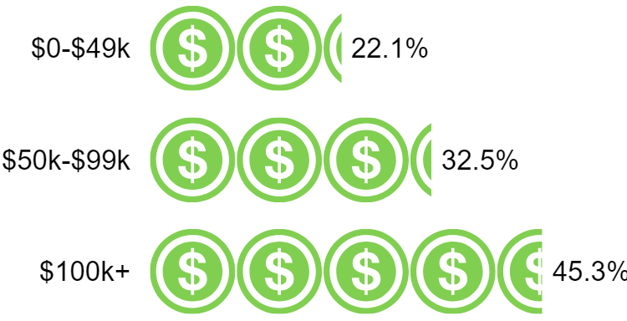

Demographics
Sex
Age Range
Household Income
53.5% Female
46.5% Male
Geo - DMA
Education
Race/Ethnicity
40.5%
have at least
a College degree
58.6% have no college degree
Partisanship
Ideology
General Election X of 4
Sample size: 600

Slide 14

contact
Chris Lane
Pollster & Director of Client Strategy
chrisl@cygn.al
C: +1 (774) 364-2035
900 17th Street NW #950
Washington, DC 20006

